Slide 1
Poet
Maya Angelou

Slide 2
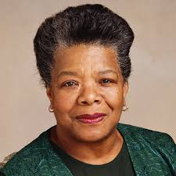
Maya Angelou (Marguerite Johnson in St. Louis, Missouri) 1928-2014
An acclaimed
poet, storyteller, writer,
singer, dancer, actress,
composer, educator and
Hollywood’s first female black director,
playwright, and civil right’s activist.
1993 - Angelou wrote and delivered a poem, "On The Pulse of the Morning," at the inauguration for President Bill Clinton at his request.
2000 - received the National Medal of Arts, 2010 - awarded the Presidential Medal of Freedom by President Barack Obama.

Slide 3
Poetry Background
Ms. Angelou was a child of the Civil Rights struggle, an era of racial discrimination and oppression.
Poetry challenged the indignities and inhumanity that African-Americans faced on a daily basis. Example: stereotypes of beauty and human worth.
While her voice was borne (came from) of the experiences of black Americans, her poetry came to apply to all.

Slide 4
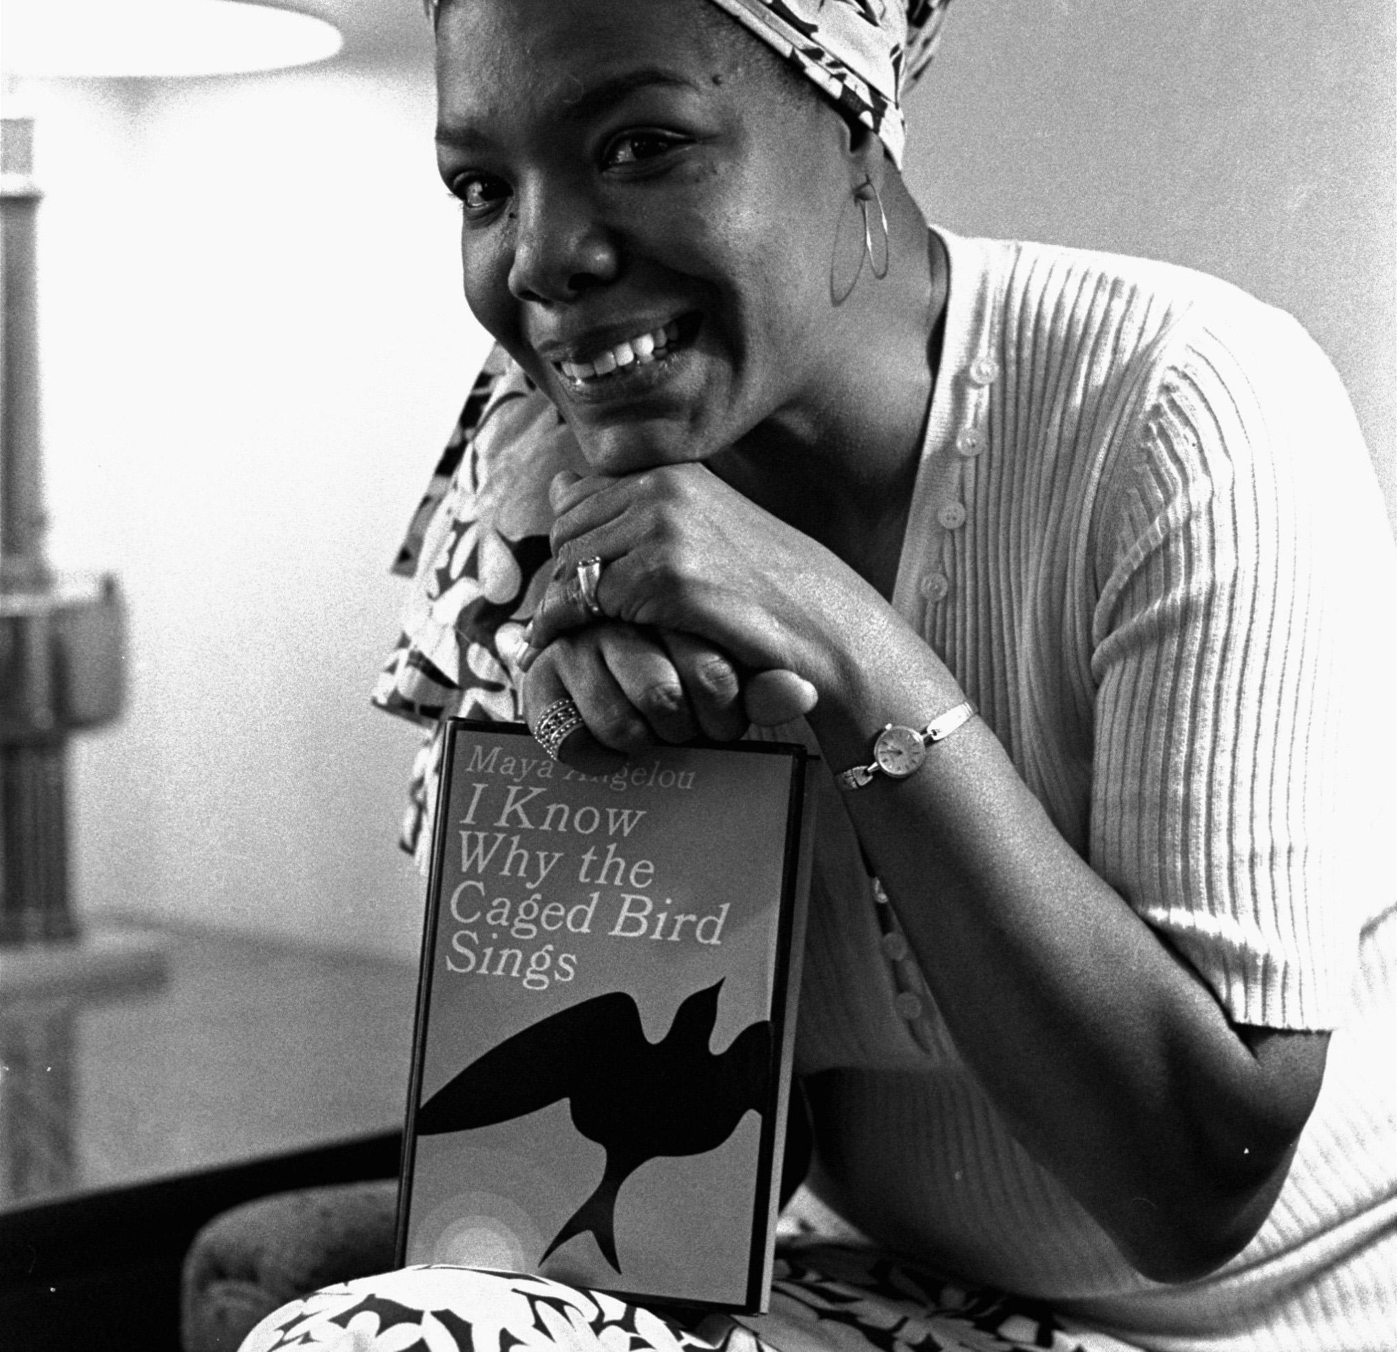
Poetry Topic Examples
Black beauty,
The strength of women,
The human spirit;
Vietnam War;
Social justice
She has also written a number of books, the most well-known is entitled, “I Know Why the Caged Birds Sing.”

Slide 5
Author’s Style
Uses a number of literary devices & techniques:
Example “Phenomenal Woman” – Free Verse
metaphors, similes
Rhythm and rhymes in: lies, size; hips, lips; please, knees, bees; teeth, feet;
Imagery as in: “the reach of my arms, span of my hips, stride of my steps, the curl of my lips”
Alliteration, personification
repetition to place emphasis on…; for effect; deeper meaning; and so you can remember,
Her poetry has a musical quality about them
https://www.poetryfoundation.org/poems/48985/phenomenal-woman
Excerpt
Pretty women wonder where my secret lies.
I’m not cute or built to suit a fashion model’s size
But when I start to tell them,
They think I’m telling lies.
I say,
It’s in the reach of my arms,
The span of my hips,
The stride of my step,
The curl of my lips.
I’m a woman
Phenomenally.
Phenomenal woman,
That’s me.
I walk into a room
Just as cool as you please,
And to a man,
The fellows stand or
Fall down on their knees.
Then they swarm around me,
A hive of honey bees.
I say,
It’s the fire in my eyes,
And the flash of my teeth,
The swing in my waist,
And the joy in my feet.
I’m a woman
Phenomenally.
Phenomenal woman,
That’s me.

Slide 6
Author’s Style cont’d
And Still I Rise – Lyric Poem
Notice the repetition of “I Rise”
Notice the comparisons (simile) “like dust, I’ll rise. “like I’ve got oil wells pumping in my living room”
Notice the metaphor “I am a black ocean, leaping and wide ….tide”
The repetition of “I Rise” is empowering. It’s the theme, the lesson of the poem that no matter what injustice you may do to me, or think of me I will overcome, I will get up. You can’t keep me down, Still I rise.
It rhymes, got rhythm, it’s got confidence.
https://www.poetryfoundation.org/poems/46446/still-i-rise
You may write me down in history
With your bitter, twisted lies,
You may trod me in the very dirt
But still, like dust, I'll rise.
Does my sassiness upset you?
Why are you beset with gloom?
’Cause I walk like I've got oil wells
Pumping in my living room.
Out of the huts of history’s shame
I rise
Up from a past that’s rooted in pain
I rise
I'm a black ocean, leaping and wide,
Welling and swelling I bear in the tide.

Slide 7
Literary Devices
Serve as a tool for writers to bring clarity and richness. With the help of literary devices, they not only give underlying meanings to their texts but also make their texts unique and appealing. (Literarydevices.net)

Slide 8
Poetry
Poetry is one method of letting your voice be heard.
Many types/forms of poetry
But how you use the literary devices and techniques will give your voice greater impact.
'The idea is to write it so that people hear it and it slides through the brain and goes straight to the heart.'
Maya Angelou

